Slide 1
Definition
Virtualization is the ability to run multiple operating systems on a single physical system and share the underlying hardware resources
It is the process by which one computer hosts the appearance of many computers.
Virtualization is used to improve IT throughput and costs by using physical resources as a pool from which virtual resources can be allocated.

Slide 2
The process of virtualization consists of two parts:
(1) The mapping of virtual resources or state,
e.g., registers, memory, or files, to real resources in the underlying machine
(2) The use of real machine instructions and/or system calls to carry out the actions specified by virtual machine instructions and/or system calls

Slide 3
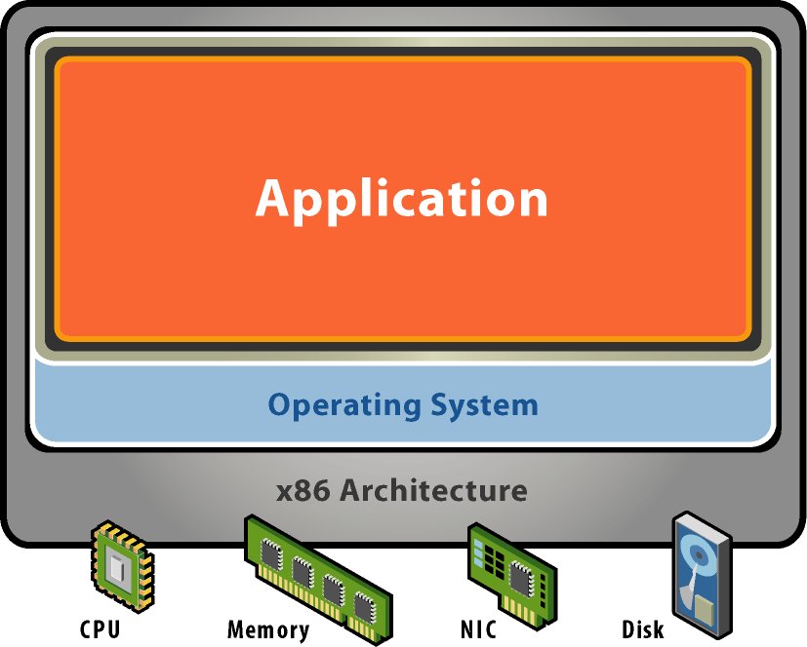
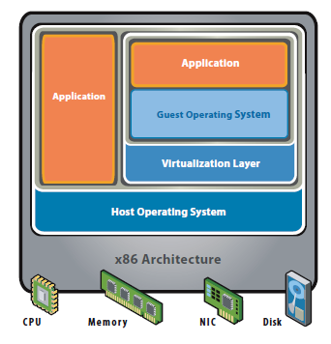
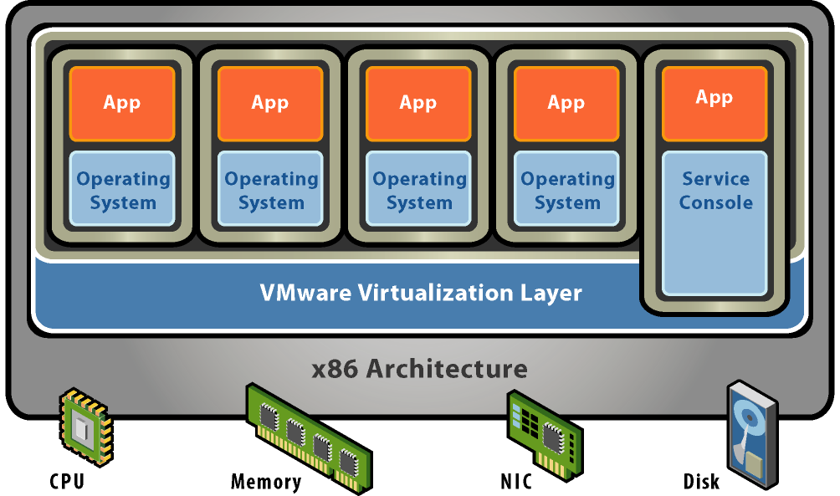
Architecture Differences
Traditional 1.
Hosted virtualization
Bare-metal virtualization
2. 3.

Slide 4
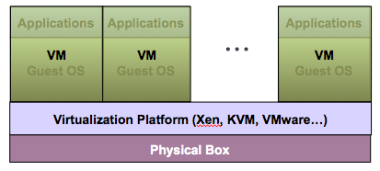
Virtualization Architecture
A Virtual machine (VM) is an isolated runtime environment (guest OS and applications)
Multiple virtual systems (VMs) can run on a single physical system

Slide 5
Benefits of Virtualization
Sharing of resources helps cost reduction
Isolation: Virtual machines are isolated from each other as if they are physically separated
Persistent and Non Persistent
Support for keep/drop the changes made in VM images
Hardware Independence: Virtual machines run independently of underlying hardware
Portability: Virtual machines can be migrated between different hosts.

Slide 6
Undoable and Append
Allows undo and append options in VM images
Reusable
One VM created can be reused somewhere else
Load balancing
Create VM for new work loads
Increased Resource utilization
Create VM in the under utilized resources

Slide 7

Virtualization Functions and Benefits
Virtual
Resources
Virtual
Resources
Sharing
Aggregation
Resources
Resources
Benefits: Resource utilization, workload manageability, flexibility, isolation
Benefits: Management simplification, investment protection, scalability
Resource Type Y
Virtual
Resources
Virtual
Resources
Emulation
Insulation
Resource Type X
Resources
Add, Replace, or Change
Resources
Benefits: Compatibility, investment protection, interoperability, flexibility
Benefits: Continuous availability, flexibility, investment protection
Notes:
7

Slide 8
Virtualization in Cloud Computing
Cloud computing takes virtualization one step further:
You don’t need to own the hardware
Resources are rented as needed from a cloud
Various providers allow creating virtual servers:
Choose the OS and software each instance will have
The chosen OS will run on a large server farm
Can instantiate more virtual servers or shut down existing ones within minutes
You get billed only for what you used

Slide 9
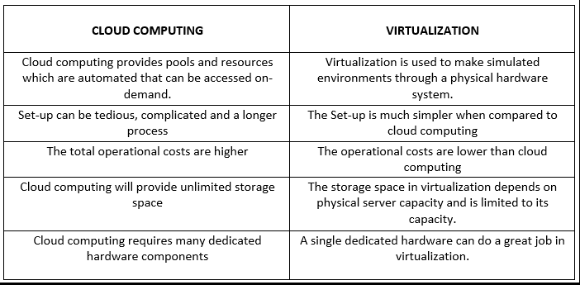
Cloud computing Vs Virtualization:

Slide 10
Hypervisor
A hypervisor, a virtual machine manager/monitor (VMM), or virtualization manager,
It is a program that allows multiple operating systems to share a single hardware host.
Guest operating system appears to have the host's processor, memory, and other resources all to itself.
Hypervisor is actually controlling the host processor and resources, allocating what is needed to each operating system in turn and making sure that the guest operating systems (called virtual machines) cannot disrupt each other.

Slide 11
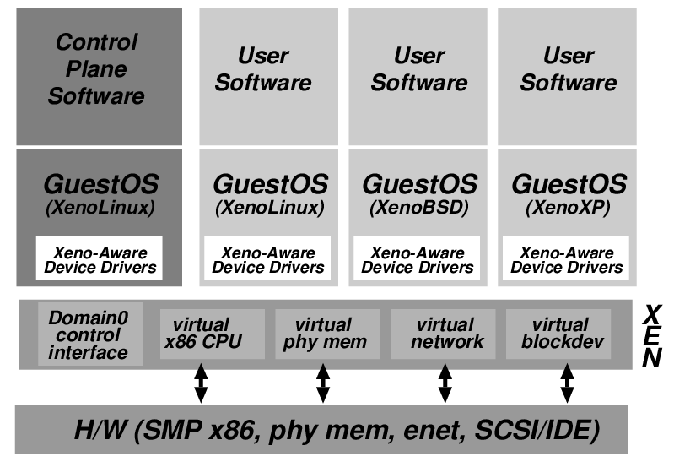
Xen Virtualization Architecture and the Threat Model
Management VM – Dom0
Guest VM – Dom
Dom0 may be malicious
Vulnerabilities
Device drivers
Careless/malicious administration

Slide 12
Virtualization Security Requirements
Scenario: A client uses the service of a cloud computing company to build a remote VM
A secure network interface
A secure secondary storage
A secure run-time environment
Build, save, restore, destroy

Slide 13
Virtualization Security Requirements
A secure run-time environment is the most fundamental
The first two problems already have solutions:
Network interface: Transport layer security (TLS)
Secondary storage: Network file system (NFS)
The security mechanism in the first two rely on a secure run-time environment
All the cryptographic algorithms and security protocols reside in the run-time environment

Slide 14

Hypervisor Vulnerabilities
Malicious software can run on the same server:
Attack hypervisor
Access/Obstruct other VMs
Guest VM1
Guest VM2
Apps
Apps
OS
OS
Hypervisor
servers
Physical Hardware

